Slide 1

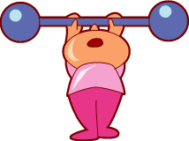


Ms. Nirode’s
Total Body Workout
Equipment Needed:
Rubber resistance bands
Circuit Training/Interval Training
Works all your major muscle groups…
Get your heart pumping…
Tone your muscles…
Burn calories…

Slide 2

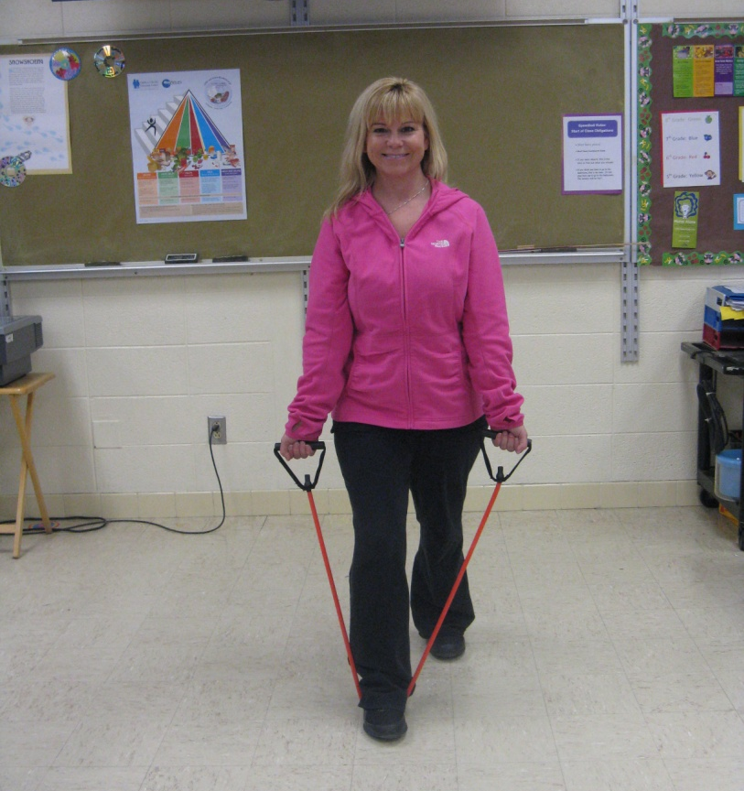
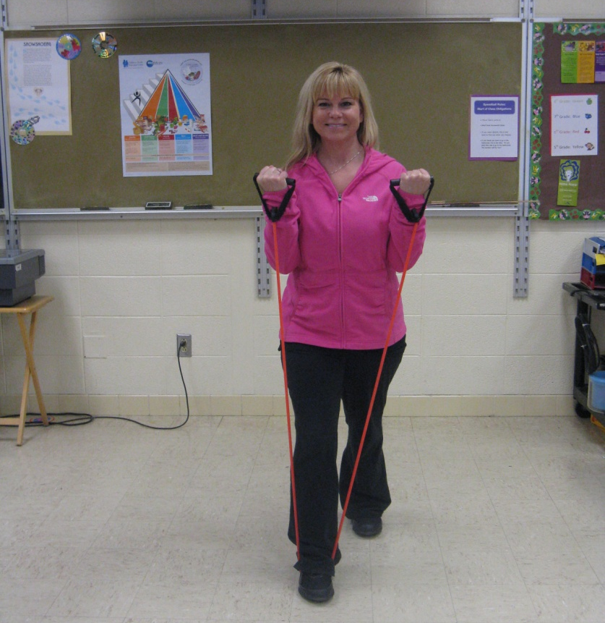
Bicep Curl
Notes:
You can use 1 leg or 2 to create the resistance needed.
Do NOT move your back.
Use your arms to stretch band to your shoulders and slowly back down to the starting position.

Slide 3
March it out!

Slide 4
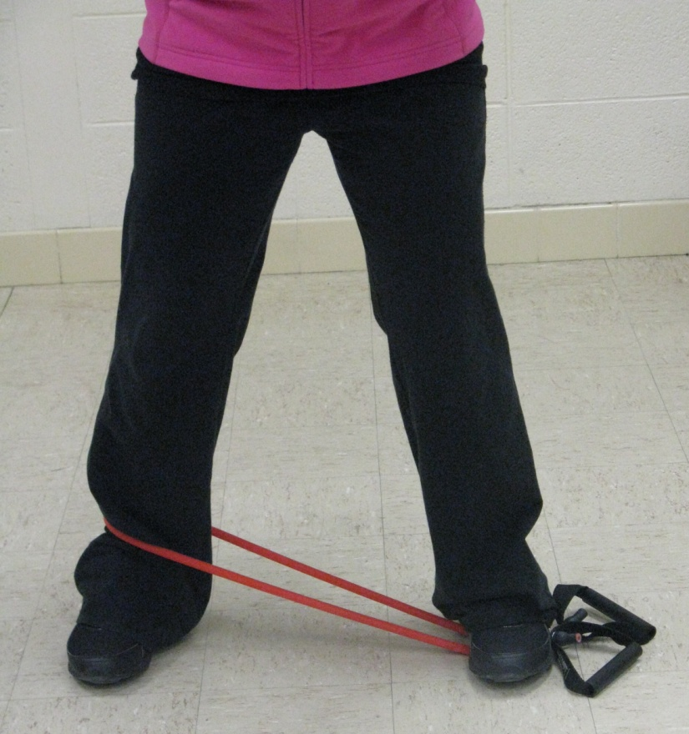
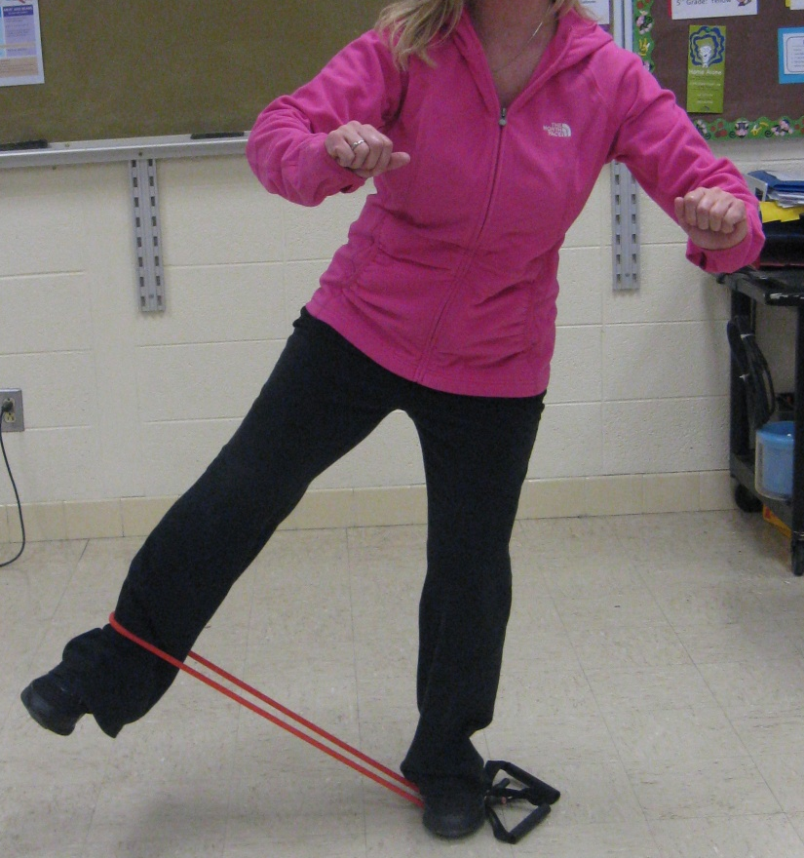
Leg Abducter
Notes:
Place the band on the floor with the handles together.
Step on the band, not the handles.
Kick up working leg and try to hold it for a second before bringing leg back down to starting position.

Slide 5
March it out!

Slide 6
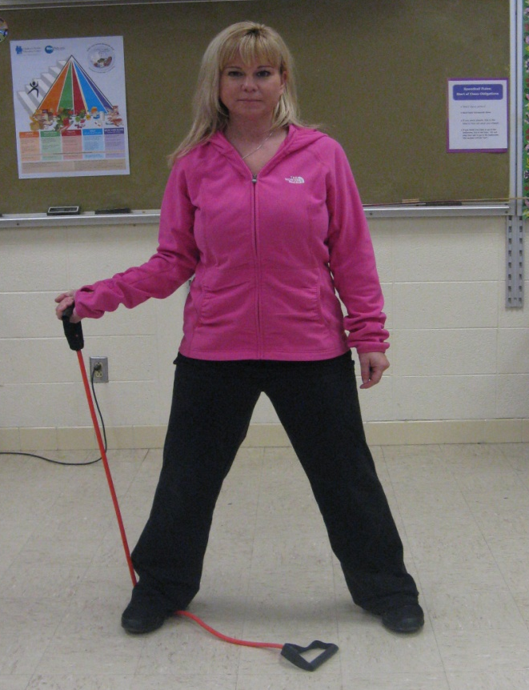
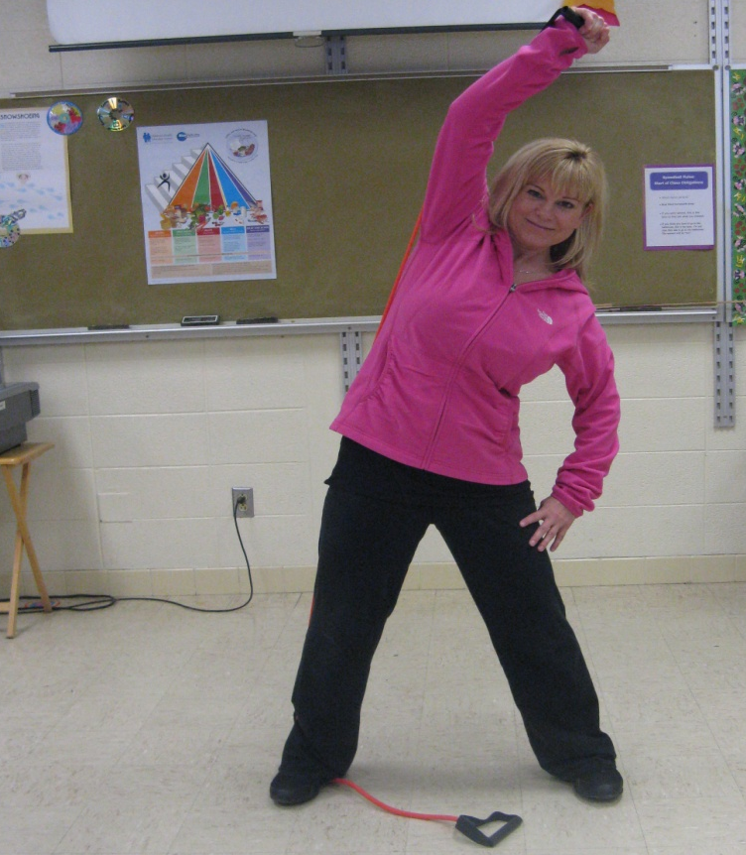
Side Bend
Notes:
You are working your obliques (side abs).
You can adjust the resistance by shortening the length of the band.
Stretch the band over your head doing a side bend.

Slide 7
March it out!

Slide 8
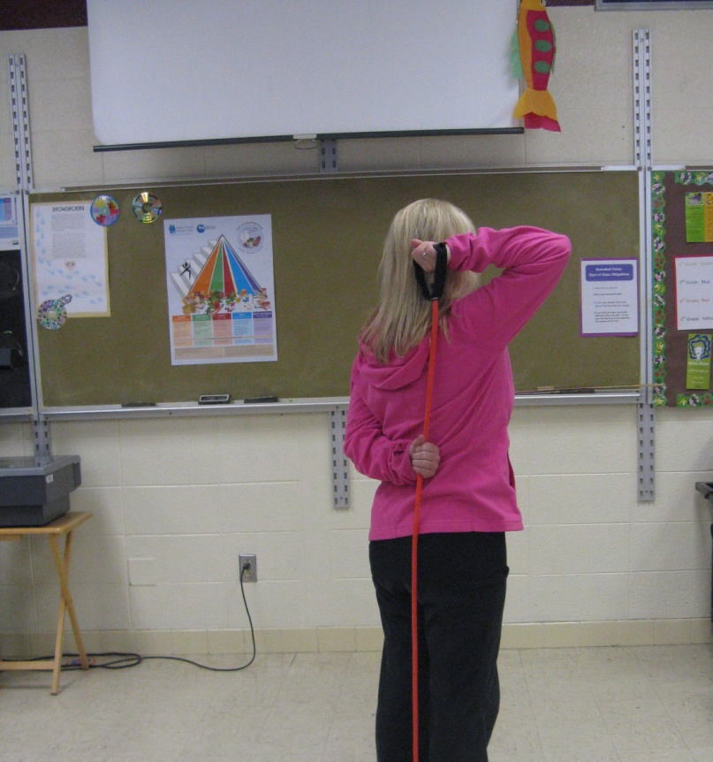
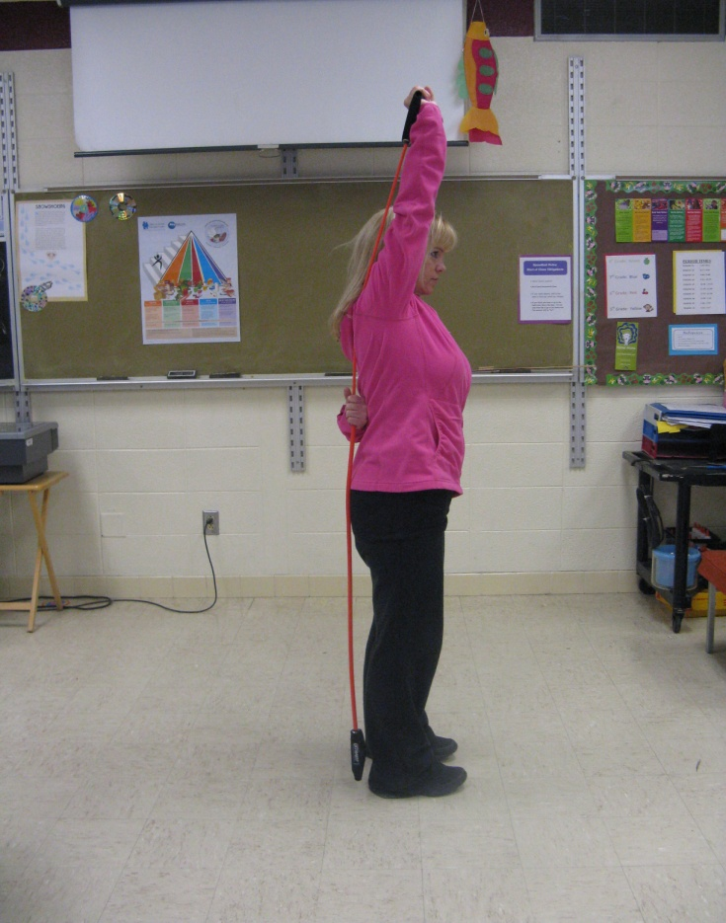
Tricep Extenstion
Notes:
Tricep extension
If standing on the band does not provide enough resistance, hold the band with your opposite hand.

Slide 9
March it out!

Slide 10
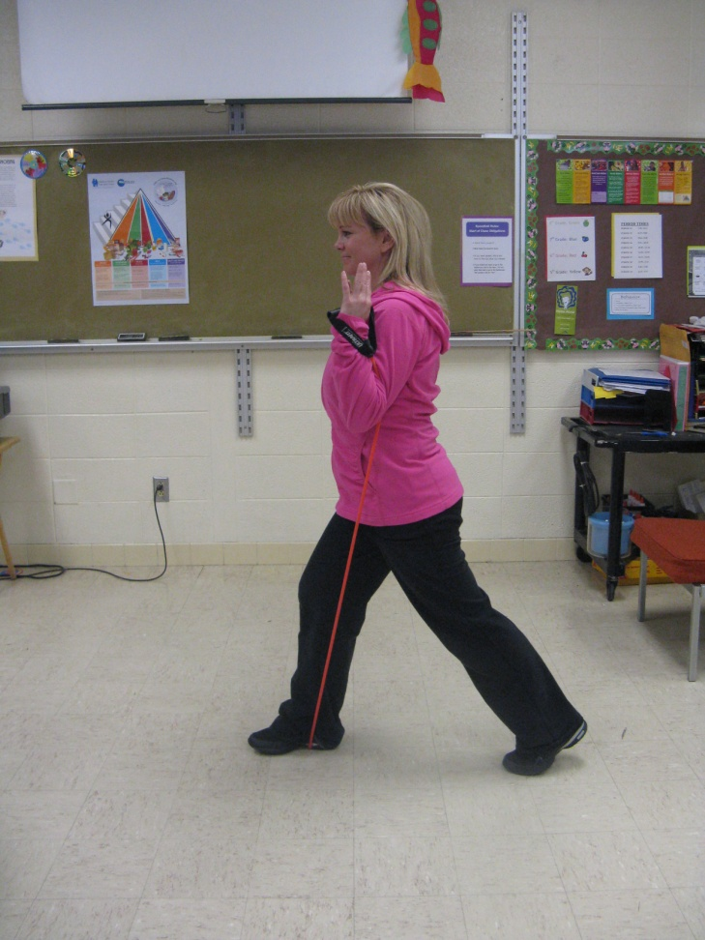
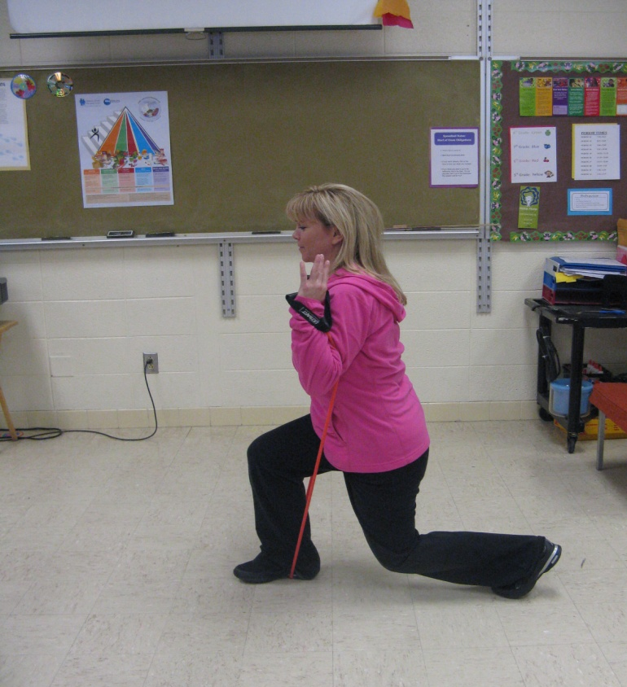
Lunge
Notes:
Never let your knee cross the imaginary line of your toe.
For this particular lunge you are only bending your back leg. (90 degree angle)
Keep your weight over the band or it will snap back at you.
To modify this move, don’t use the band. Master the move first!

Slide 11
March it out!

Slide 12
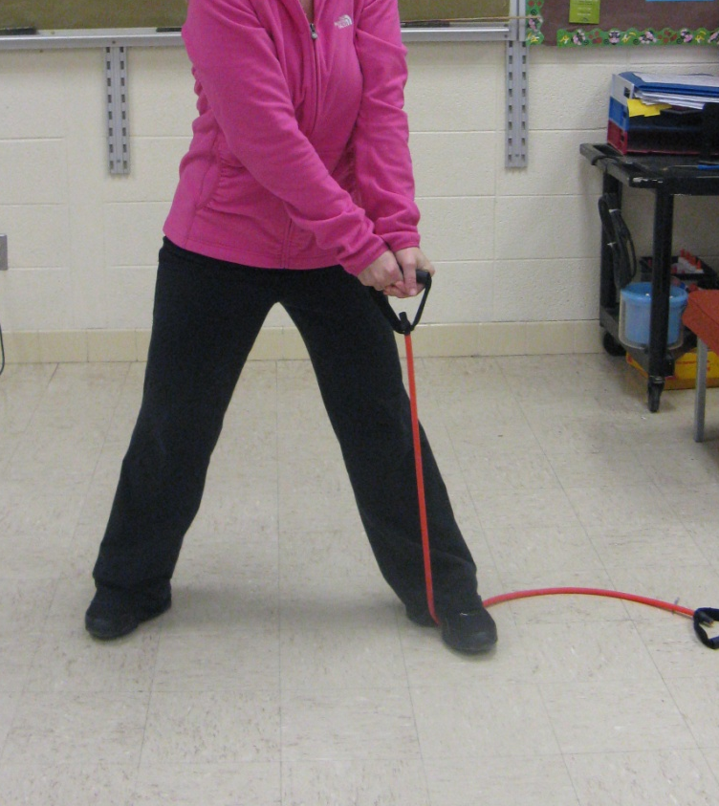
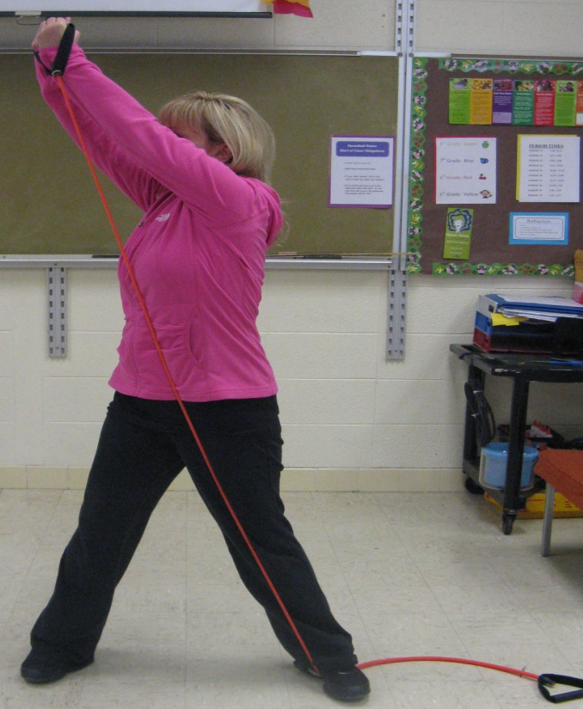
Ab Chops
Notes:
Twist your trunk (ab area) from one side (low) to the other (high).
Concentrate on using your abs as much as possible for this movement. Twist from one side to the other.

Slide 13
March it out!

Slide 14
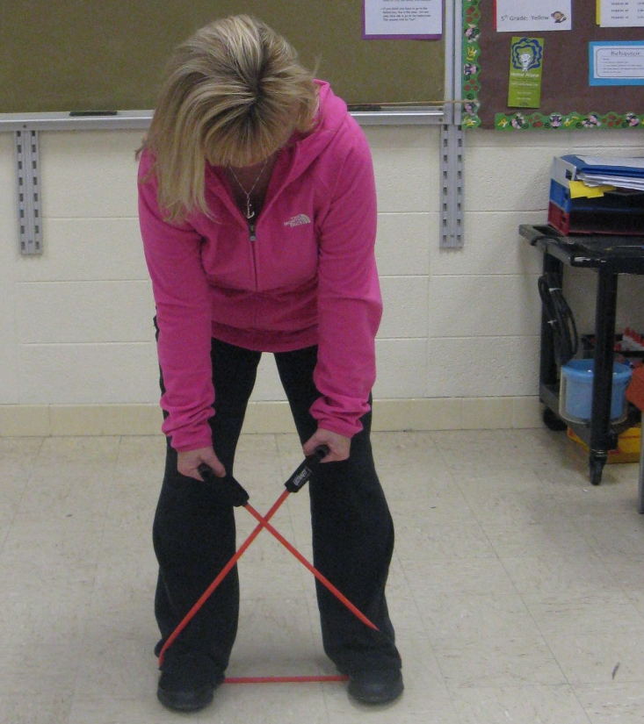
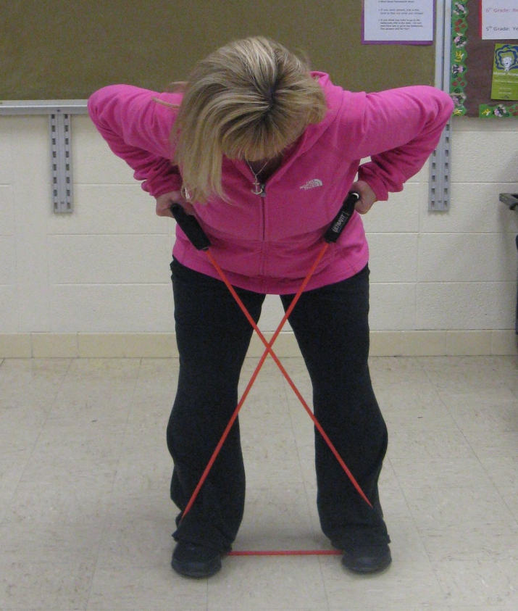
Bent Over Row
Notes:
Keep your back flat.
Try to squeeze your elbows together behind your back.

Slide 15
March it out!

Slide 16

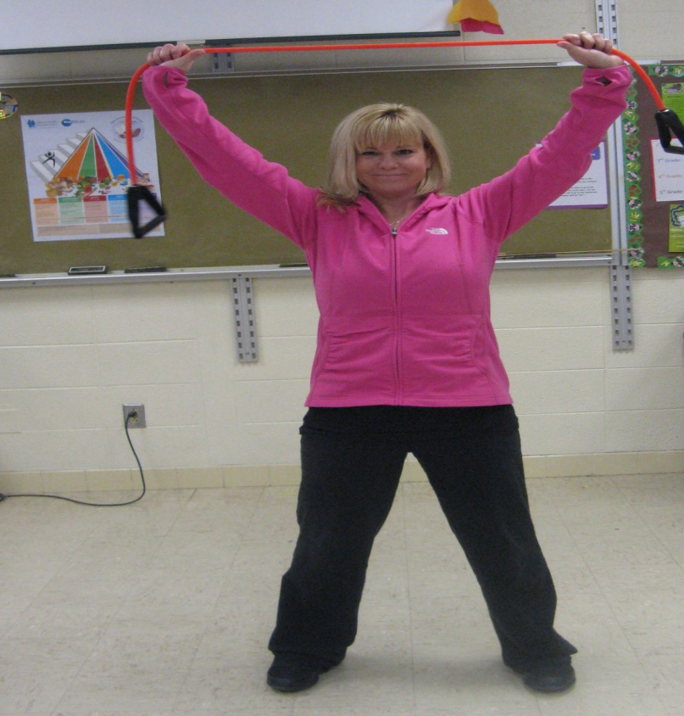
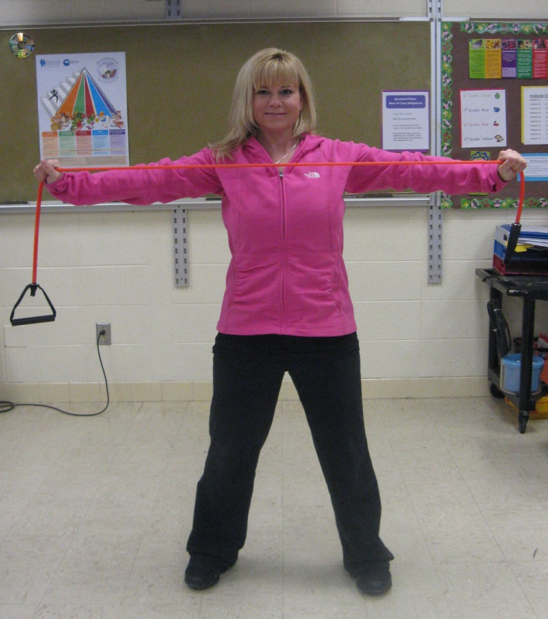
Lat Pull Down
Notes:
Keep your arms straight with only a slight bend at elbow.
Stretch band to chest and slowly lift back to starting position.

Slide 17
March it out!

Slide 18
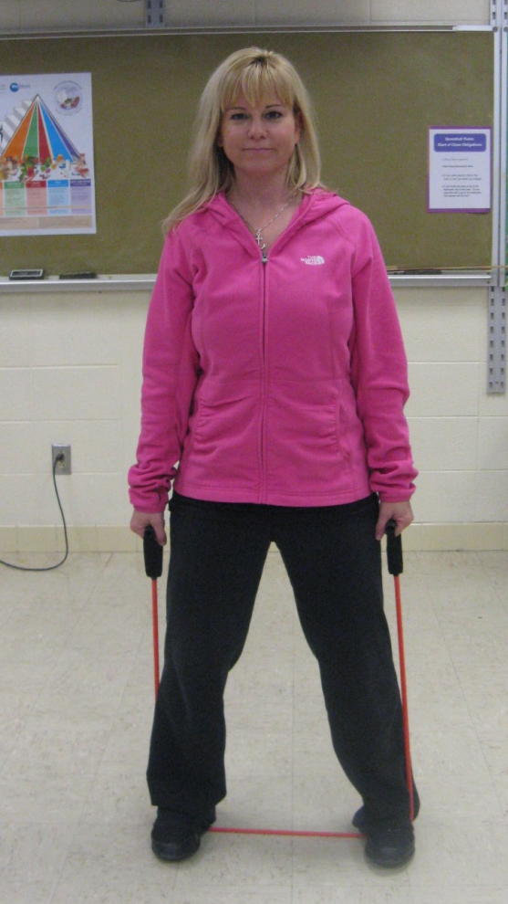
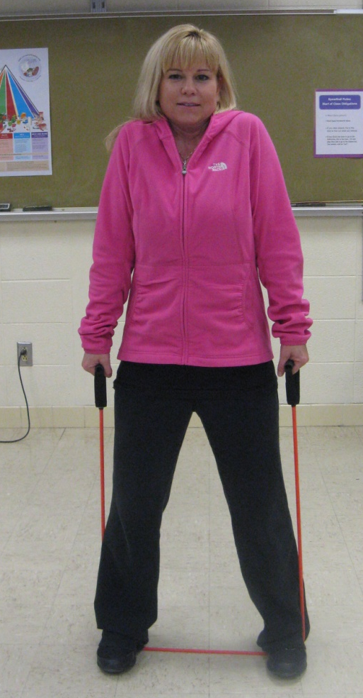
Shoulder Shrug
Notes:
1. Squeeze shoulders up and slowly lower back to starting position.

Slide 19
March it out!

Slide 20
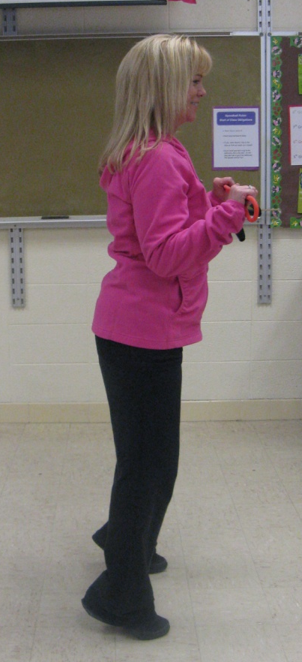
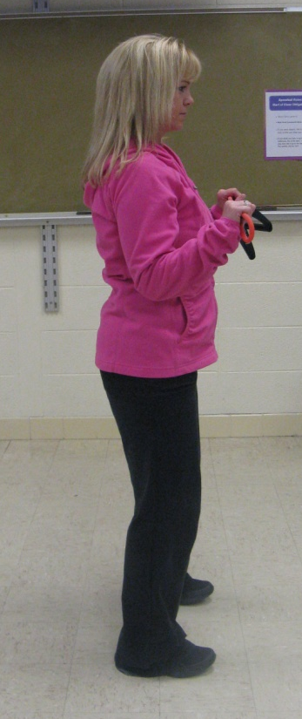
Calf Raises
Notes:
You do not need a band for this exercise.
You can stand on a block or a book to make it more challenging. Lift body up onto tip toes, slowly lower back to starting position.

Slide 21
March it out!

Slide 22
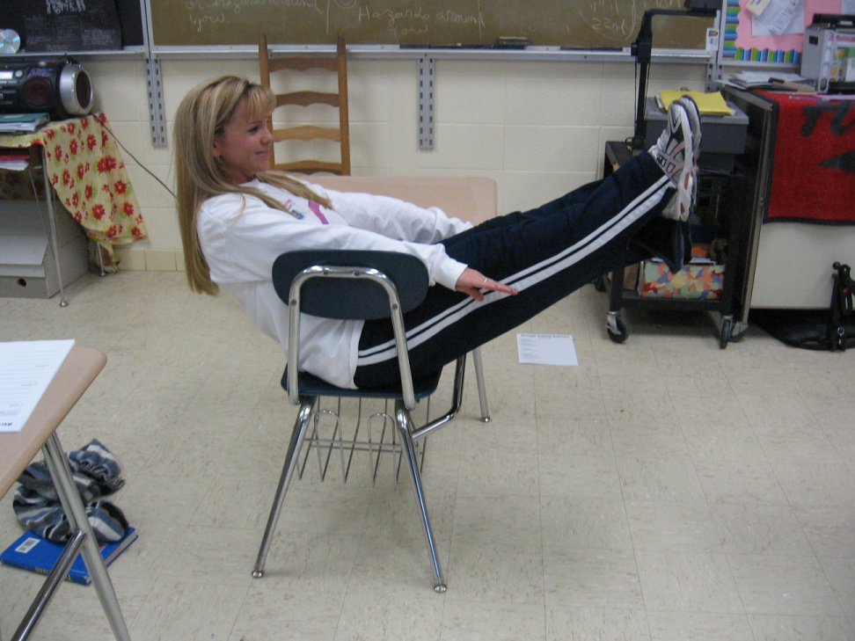
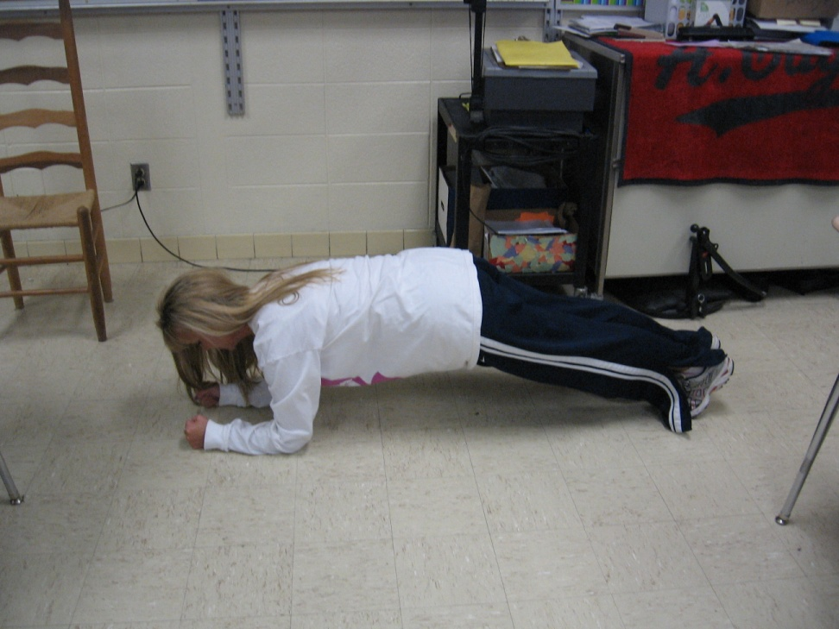
V-sit/Plank

Slide 23
March it out!

Slide 24
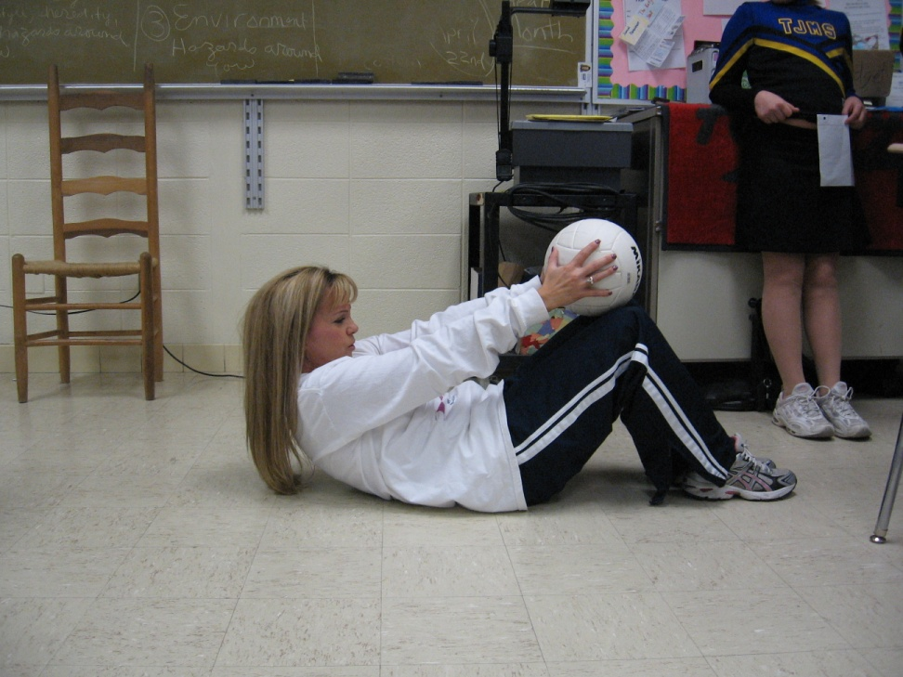
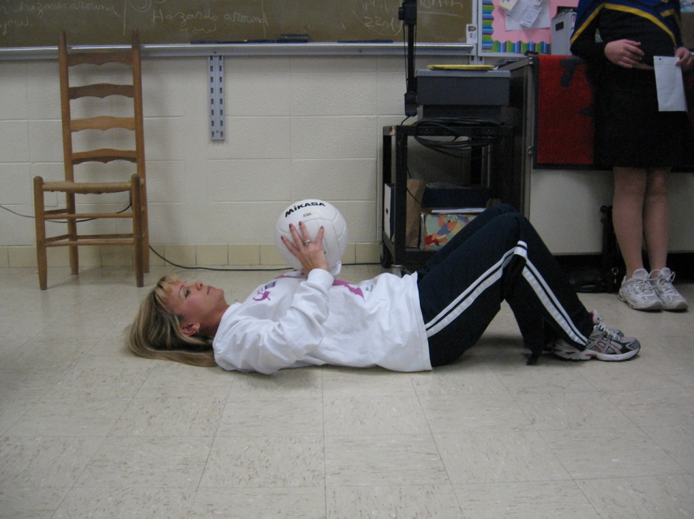
Crunch: Ball Lift

Slide 25
V-sit/Plank

Slide 26
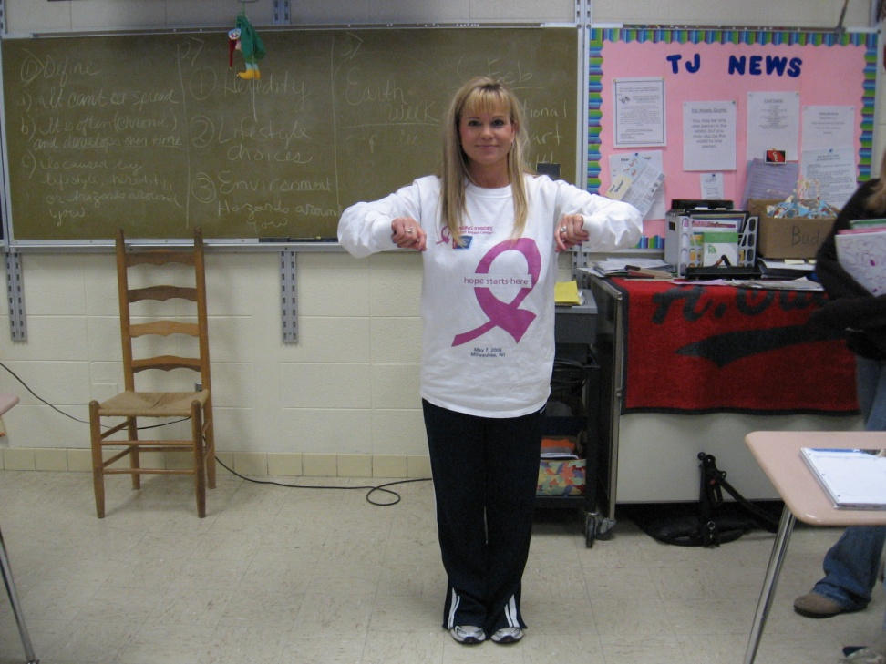
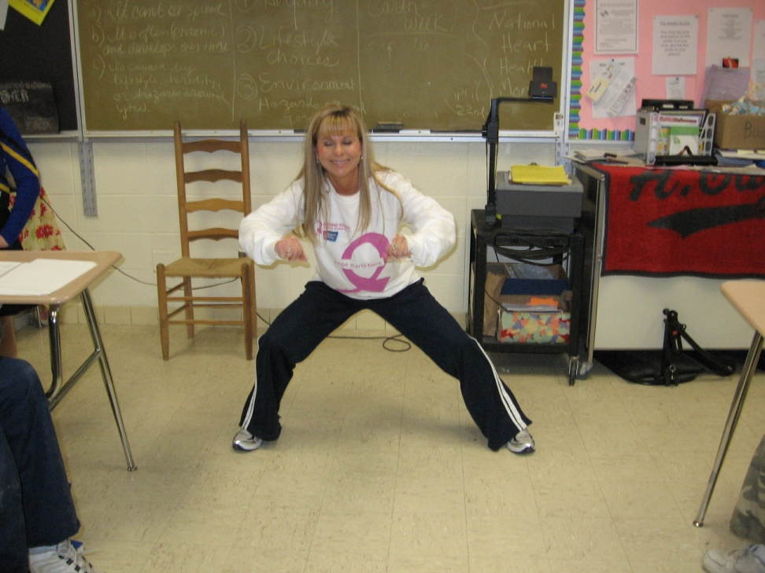
Side Lunge

Slide 27
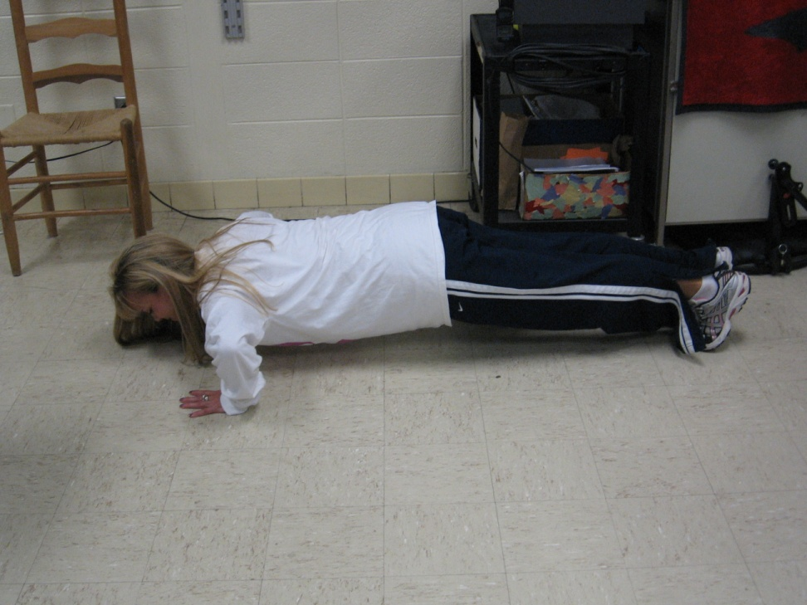
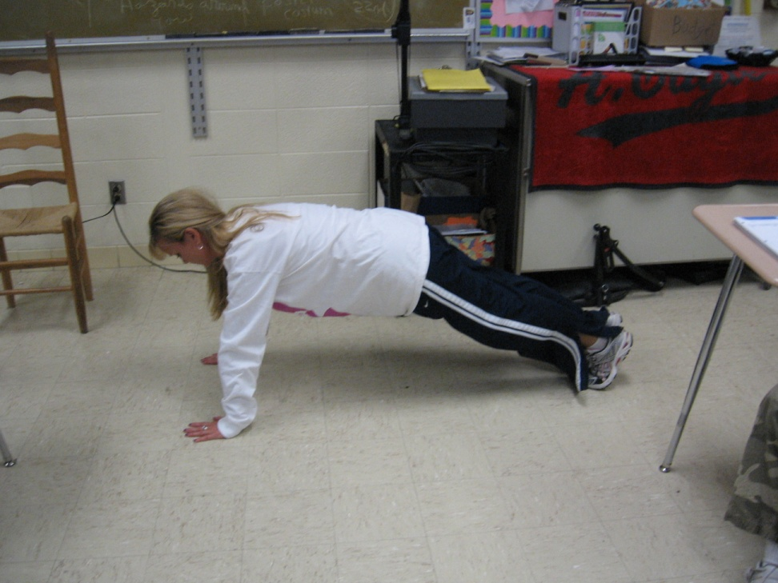
Push Up

Slide 28
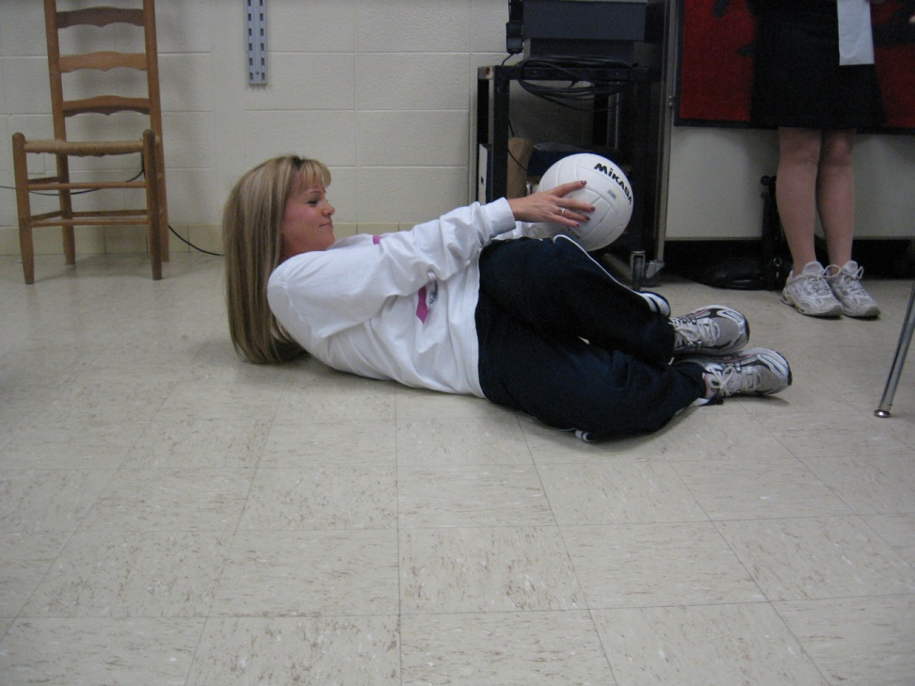
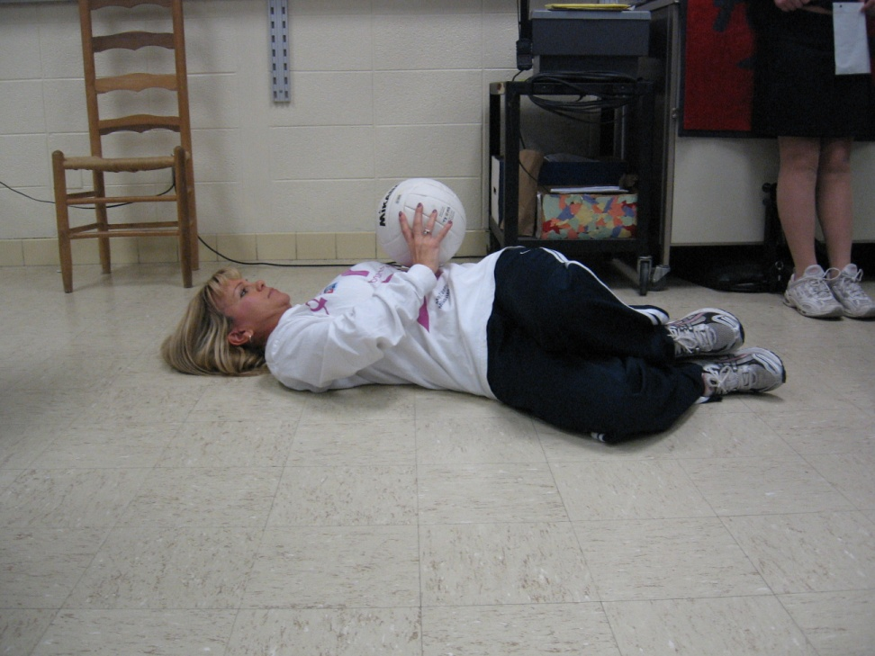
Side crunch with Ball

